Slide 1

Learning Targets: I can…
1. List, in order, the 7 habits of highly effective people.
2. Explain each of the 7 habits of effective people.
3. Use the 7 habits to live my best life possible!
Do Now: What do you know about the 7 habits of highly effective people?
Lesson
Demonstration
Lab time
Ticket out the door

Slide 2
Learning Targets: I can…
1. List, in order, the 7 habits of highly effective people.
2. Explain each of the 7 habits of effective people.
3. Use the 7 habits to live my best life possible!
The 7 Habits of Highly Effective People
The 7 Habits provide a holistic, integrated approach to personal and interpersonal effectiveness. We are not our habits and we have the control to make or break them. We are in control of our own actions, choices and destinies and must plan ahead to become the best person we can be. We must plan ahead, work together and take care of ourselves along the way.

Slide 3
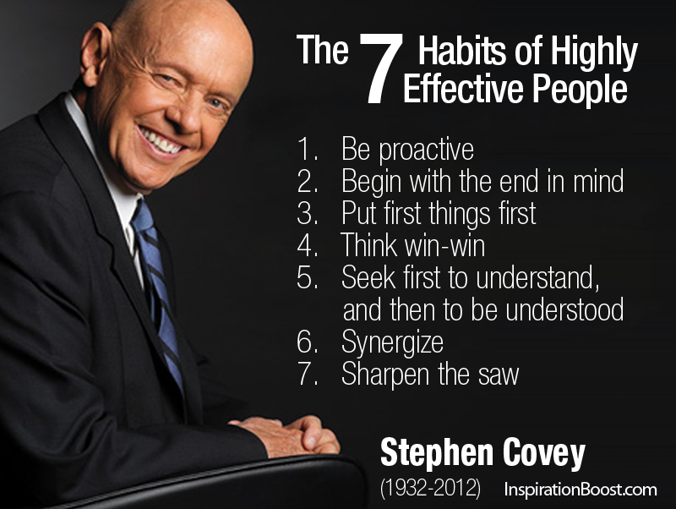
Learning Targets: I can…
1. List, in order, the 7 habits of highly effective people.
2. Explain each of the 7 habits of effective people.
3. Use the 7 habits to live my best life possible!
Is there an acronym you can use to help you remember
BBPTSSS?

Slide 4
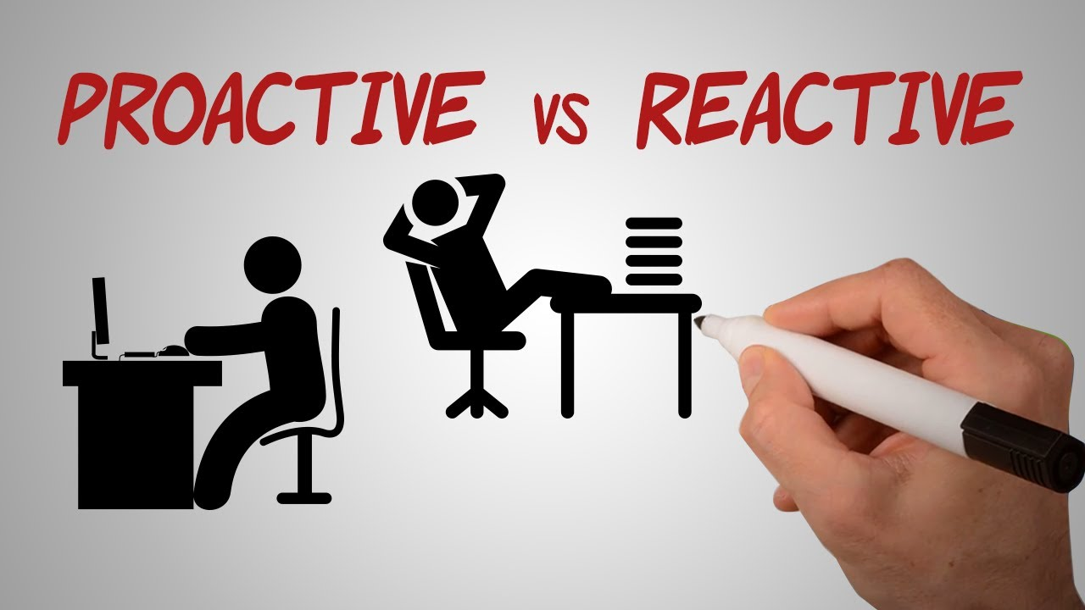
Learning Targets: I can…
1. List, in order, the 7 habits of highly effective people.
2. Explain each of the 7 habits of effective people.
3. Use the 7 habits to live my best life possible!
1. Be Proactive: Habit of Personal Vision
Being proactive means we are responsible for our own lives and we have the ability to choose how we will respond to a situation. The opposite of proactive is reactive. A reactive person puts blame on conditions or other people, for their behavior. A proactive person says, “I will”, “I can”, and “I choose to”. A reactive person says, “I can’t”, “I have to”, and “That’s just the way I am.”

Slide 5

Learning Targets: I can…
1. List, in order, the 7 habits of highly effective people.
2. Explain each of the 7 habits of effective people.
3. Use the 7 habits to live my best life possible!
2. Begin with the End in Mind: Habit of Personal Leadership
Begin with the end in mind means to begin each day or task with a clear understanding of your desired direction and destination. It is in this habit you begin to develop a personal mission statement. It focuses on what you want to be (character) and do (contribution). It examines your roles in life in a much deeper meaning.

Slide 6
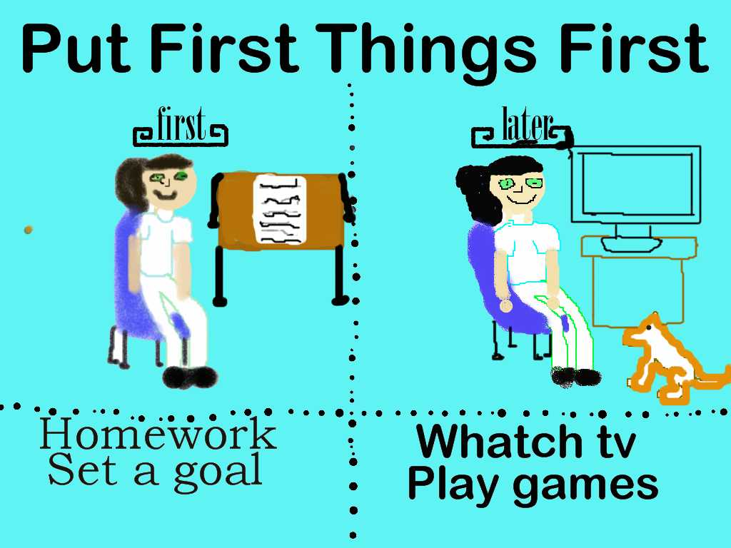
Learning Targets: I can…
1. List, in order, the 7 habits of highly effective people.
2. Explain each of the 7 habits of effective people.
3. Use the 7 habits to live my best life possible!
3. Put First Things First: Habit of Personal Management
First things are those things you find are more important to reaching your goals and maintaining a healthy lifestyle. This habit involves organizing and managing time and events according to the personal priorities you established in Habit 2. Use your time wisely by effectively planning.

Slide 7
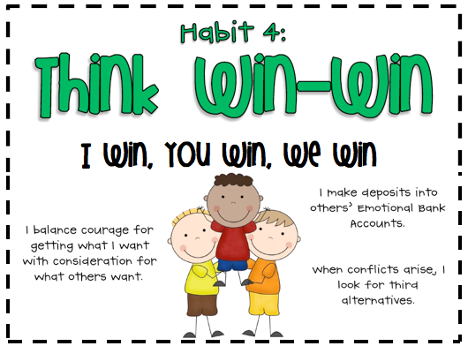
Learning Targets: I can…
1. List, in order, the 7 habits of highly effective people.
2. Explain each of the 7 habits of effective people.
3. Use the 7 habits to live my best life possible!
4. Think Win-Win: Habit of Interpersonal Leadership
Most of us base our self worth on comparison and competition. We think of ourselves succeeding when we win and the other person fails. Win-win sees life as a cooperative arena, not a competitive one. Win-win is a frame of mind and heart that constantly seeks mutual benefit in all human interactions.

Slide 8

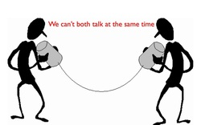
Learning Targets: I can…
1. List, in order, the 7 habits of highly effective people.
2. Explain each of the 7 habits of effective people.
3. Use the 7 habits to live my best life possible!
5. Seek First to Understand, Then to be Understood: Habit of Communication
Communication is the most important skill in life. Seek first to understand or “Diagnose Before You Prescribe” is a correct principal manifest in many areas of life. “Empathetic Listening” gets inside another person’s frame and reference and allows you to see the world the way he/ she sees it.

Slide 9
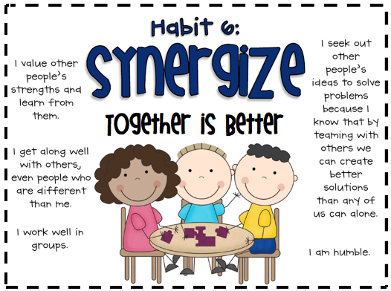
Learning Targets: I can…
1. List, in order, the 7 habits of highly effective people.
2. Explain each of the 7 habits of effective people.
3. Use the 7 habits to live my best life possible!
6. Synergize: Habit of Creative Cooperation
Synergy is the achievement of all the other habits. It is teamwork, team building, and the development of unity and creativity with others. The essence of synergy is valuing difference and bringing those perspectives together in the spirit of mutual respect. It represents a win-win for both parties.

Slide 10
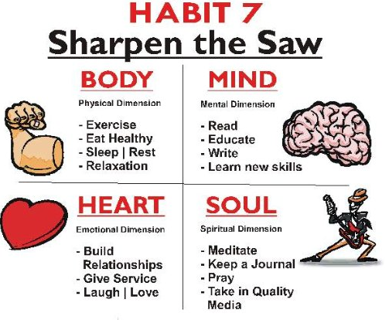
Learning Targets: I can…
1. List, in order, the 7 habits of highly effective people.
2. Explain each of the 7 habits of effective people.
3. Use the 7 habits to live my best life possible!
7. Sharpen the Saw: Habit of Self-Renewal
Sharpening the saw means preserving and enhancing the greatest asset you have – YOU! It means have a balanced, systemic program for self-renewal in four areas of life: physical, social/emotional, mental and spiritual. These four areas need to be exercised to keep us effective in all of the habits.

Slide 11

Learning Targets: I can…
1. List, in order, the 7 habits of highly effective people.
2. Explain each of the 7 habits of effective people.
3. Use the 7 habits to live my best life possible!
Ticket out the door:
How can you use the 7 habits of highly effective people to live your best life possible?

